Slide 1

Dynamic Blog Web
Pratyush Singh

Slide 2
Abstract
This project aims to develop a dynamic and user-friendly blog web application. The app will enable users to effortlessly create, edit, and share blog posts. It features a responsive design that adapts to various devices, an intuitive navigation system, and a robust content management system. Additionally, the app will support multimedia content, user comments, and social media integration, ensuring an engaging and interactive blogging experience for users.

Slide 3
Software Requirements
Operating system : Windows 10/11.
Coding Language : C#.net,
Frontend : ASP.Net Core, WEB API, HTML, CSS, JavaScript, JQuery, Angular 17
IDE Tool : Visual Studio code ,Visual Studio .Net, PostMan/ Webstorm
Database : SQL SERVER 2019.

Slide 4
Modules
Content Display Module
Blog Listing Page
Single Post Page
Pagination
Commenting Module
Add/Edit/Delete Comments
Nested Comments (Replies)
Like System
Search and Filtering Module
Search by Title, Content, or Author
Filter by Tags, Categories
Sort by Popularity or Latest

Slide 5
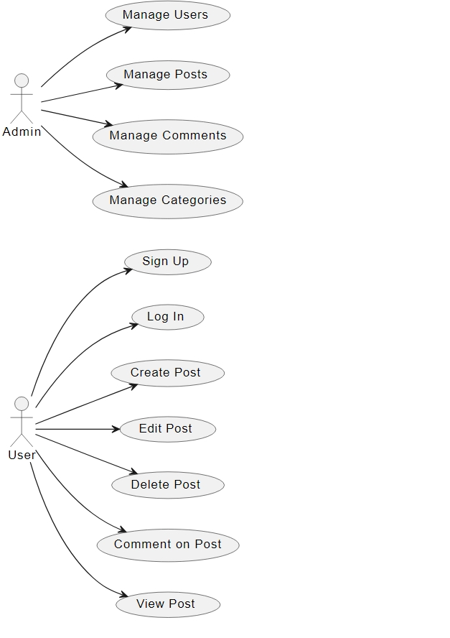
Blog Web Use Case Diagram

Slide 6
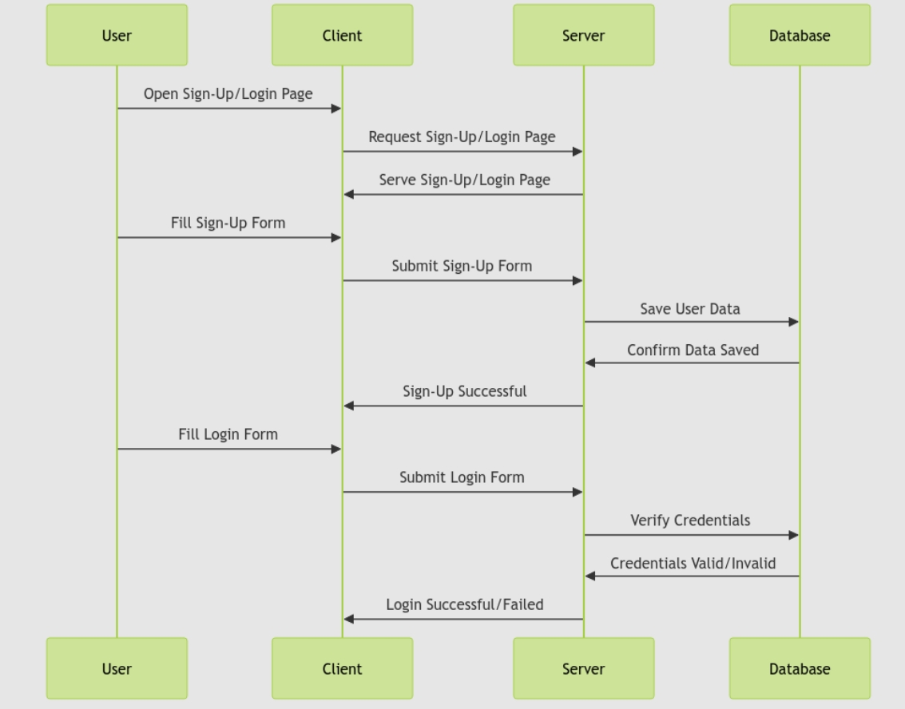
Authentication Class Diagram

Slide 7
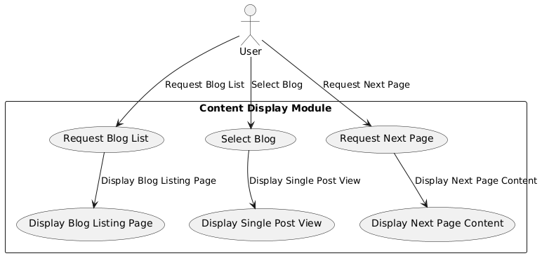
Content Display Module Use Case Diagram

Slide 8
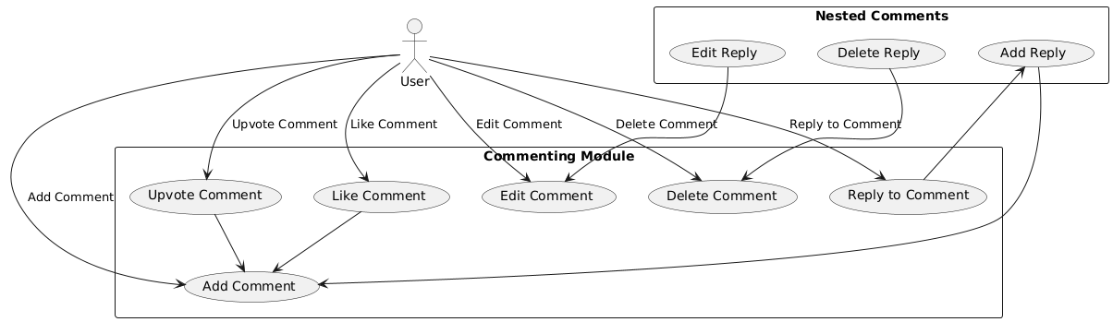
Commenting Module Use Case Diagram

Slide 9
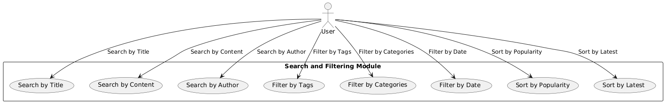
Search and Filtering Module Use Case Diagram

Slide 10
Functionalities
User Authentication and Profile Management
User registration and login system.
Password reset functionality.
Role-based access control (e.g., admin vs regular user).
Blog Post Management
Support for media uploads (e.g., images, videos).
Categorization and tagging of posts.
Option to save posts as drafts or publish them directly.
Comments and Interaction
Allow logged-in users to comment on posts.
Admins can moderate comments (approve, delete, or report).
Option to "like" or upvote comments and posts.

Slide 11


